Slide 1





E-COMMERCE SALES ANALYSIS
Project by : BHUVANESH.KR
bhuvaneshkr2003@gmail.com
912421114306
1DFA1F1233D2DDA882B4B949989D9AFD
(au912421114002)
Guide: P.RAJA
(Master trainer edunet foundation)
Notes:
Slides: Prepare a short slide deck (10-12 slides) summarizing the project objectives, methodology, and key results.

Slide 2
E-COMMERCE SALES ANALYSIS
OUTLINE
Abstract of the Project
Problem Statement
Proposed Solution
System Architecture
Live Demo of the Project
Embedded Video of Project
Conclusion
Future Scope

Slide 3
Abstract
E-COMMERCE SALES ANALYSIS
This project conducts a comprehensive analysis of e-commerce sales data to uncover key patterns and insights into customer demographics, purchasing behavior, and seasonal trends. By examining various factors, including gender distribution, popular product categories, preferred payment methods, customer interaction types, and purchase frequency, we aim to provide actionable insights to enhance marketing strategies, inventory management, and customer engagement. Seasonal analysis identifies peak buying periods, enabling optimized stock and targeted promotions. The segmentation of customers by behavior further supports personalized marketing efforts and loyalty programs, ultimately contributing to improved customer satisfaction and increased sales growth. This analysis equips decision-makers with data-driven insights to enhance platform performance and customer experience.

Slide 4
Problem Statement
E-COMMERCE SALES ANALYSIS
The objective is to analyze sales data to extract crucial information such as total sales, best-selling products, customer purchase patterns, and other vital metrics. The analysis helps the company better understand its performance, optimize marketing strategies, and improve inventory management.

Slide 5
E-COMMERCE SALES ANALYSIS
Proposed Solution
To calculate the total sales over a certain period.
To identify the best-selling products based on units sold and revenue.
To study customer purchase patterns, such as how often they buy and how much they spend.
To offer insights that will help the company improve marketing, manage stock, and engage customers better.

Slide 6
System Architecture
E-COMMERCE SALES ANALYSIS
Hardware Requirements:
1. Processor (CPU):(Minimum: Dual-core processor, Recommended: Quad-core or higher for faster data processing and model training.)
2. Memory (RAM):(Minimum: 8 GB, Recommended: 16 GB or more for handling larger datasets and running complex models)
3. Storage:(Minimum: 10 GB of available disk space, Recommended: 50 GB or more for storing datasets, models, and outputs)
4. Graphics Processing Unit (GPU):(Recommended: NVIDIA GPU with CUDA support for accelerated model training, especially for deep learning tasks. Google Colab provides access to GPUs and TPUs)
5. Network:(Reliable internet connection to access Google Colab and datasets stored online (e.g., Google Drive, Kaggle))

Slide 7
System requirement
E-COMMERCE SALES ANALYSIS
1. Operating System:(Google Colab runs in a cloud-based environment, so no specific operating system is required on the user's local machine. However, a web browser (Chrome, Firefox, etc.) is needed) 2. Programming Language:(Python 3.x: Ensure the project is compatible with Python 3, which is the default in Google Colab) 3. Libraries and Frameworks: Data Manipulation:( Pandas, NumPy) Data Visualization:(Matplotlib,Seaborn) Machine Learning:(Scikit-learn,TensorFlow or PyTorch) 4. Development Environment:(Google Colab, which provides an interactive Jupyter notebook environment with built-in support for many libraries.) 5. Version Control (Optional):(Git for tracking changes and collaborating on code (can be integrated with GitHub)) 6. Data Storage Solutions:(Google Drive for storing and accessing datasets easily within Google Colab)

Slide 8
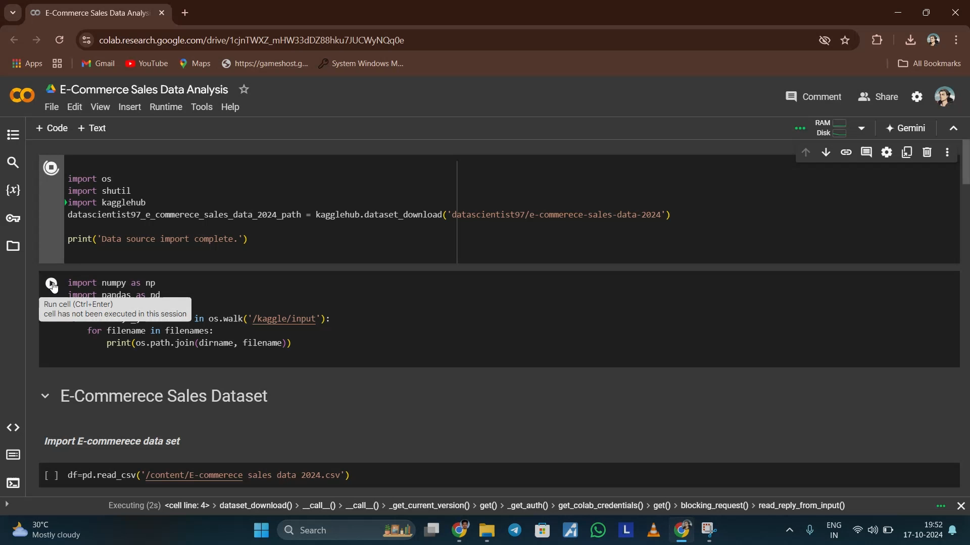
Video of Project Demo
E-COMMERCE SALES ANALYSIS

Slide 9
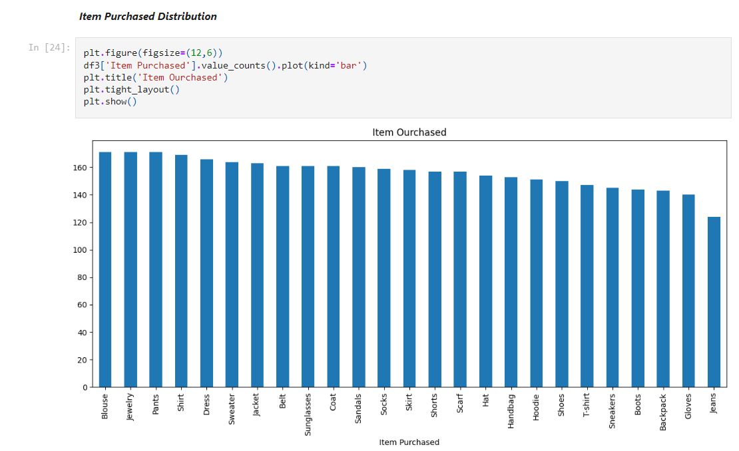
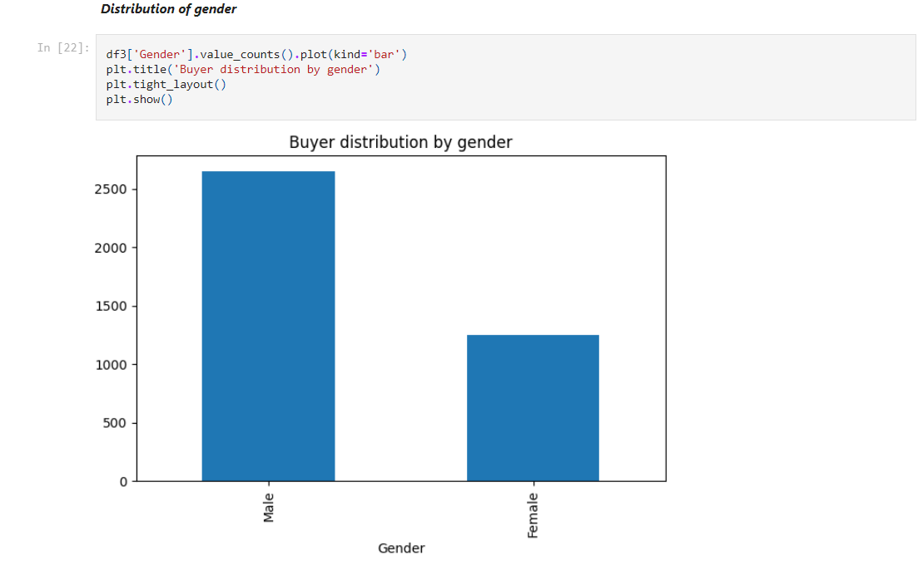
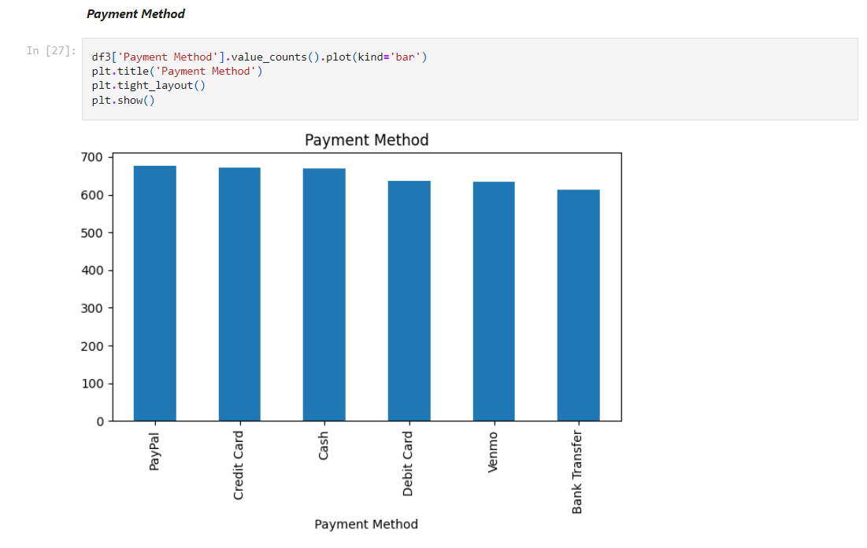
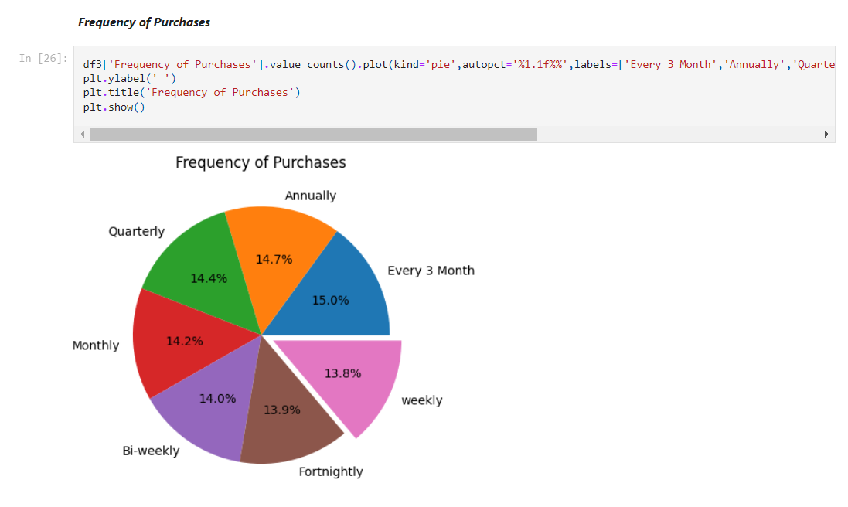
E-COMMERCE SALES ANALYSIS

Slide 10
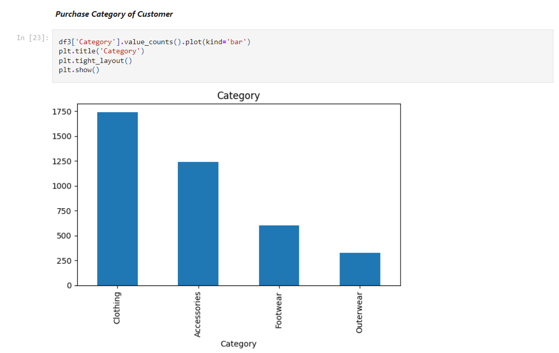
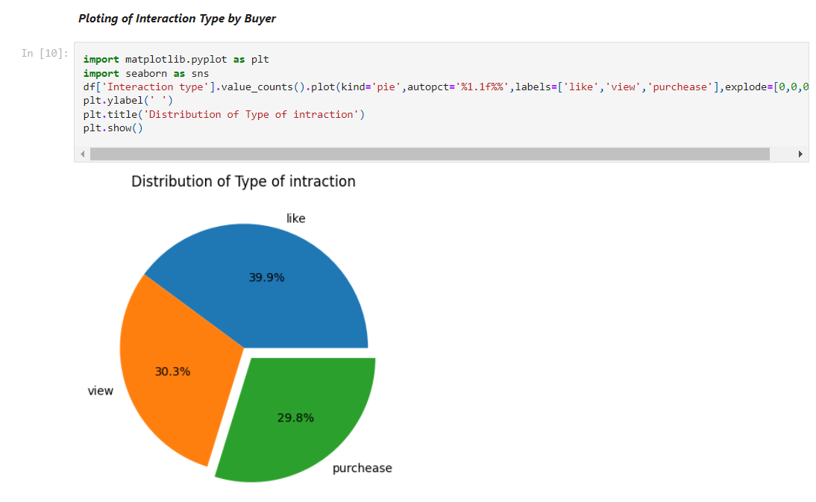
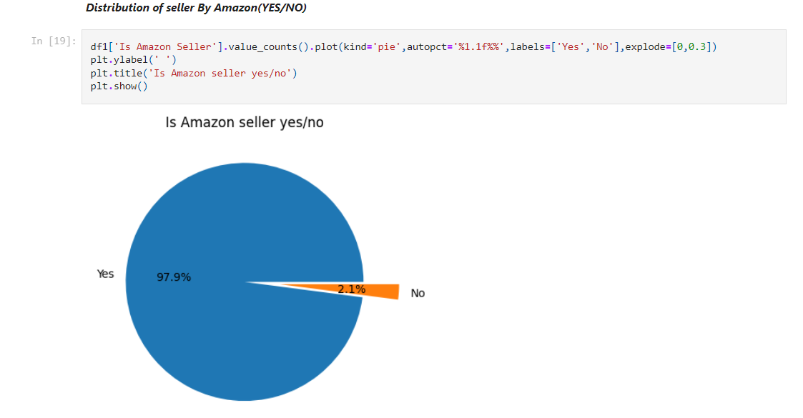
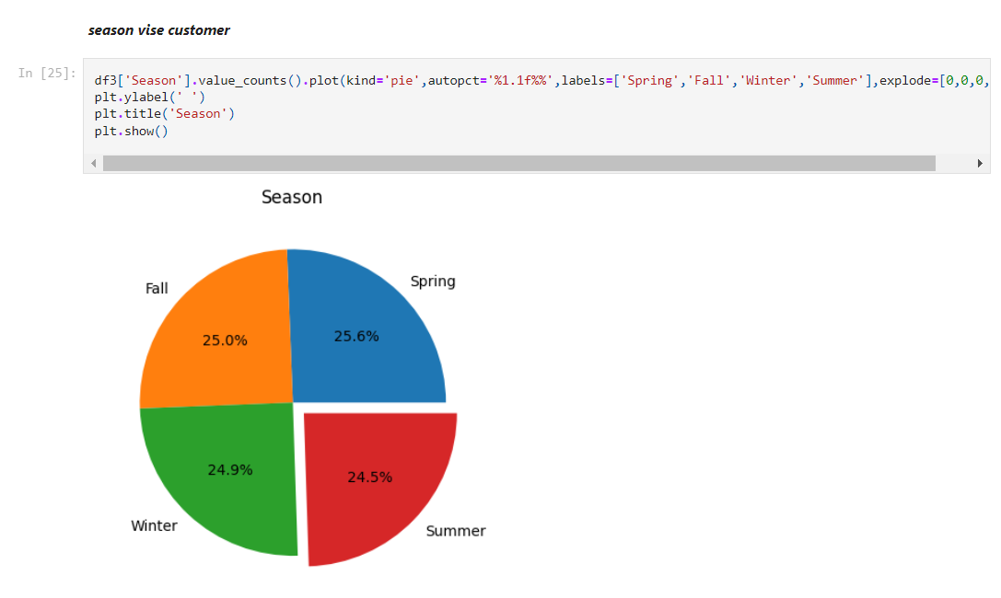
E-COMMERCE SALES ANALYSIS

Slide 11
Conclusion
E-COMMERCE SALES ANALYSIS
The analysis provides actionable insights into sales performance, enabling the company to optimize marketing efforts, adjust inventory, and target customer segments more effectively, ultimately driving revenue growth and improving customer satisfaction.
The project highlights key areas for enhancing user experience, particularly through checkout and product interaction improvements. Though there are some limitations, such as incomplete data and platform-specific focus, the analysis sets the stage for future improvements and more precise strategies in e-commerce operations and customer engagement.

Slide 12
Future Scope
E-COMMERCE SALES ANALYSIS
This project can be expanded with predictive analytics and machine learning to forecast customer behavior and enhance recommendations. Real-time data analysis can allow instant insights and personalized offers. Adding sentiment analysis of reviews would provide a better understanding of customer satisfaction, while cross-channel analysis can reveal behavioral differences across platforms, improving targeted marketing. Enhanced segmentation with psychographic data can enable highly personalized marketing and loyalty programs, boosting customer retention.

Slide 13
E-COMMERCE SALES ANALYSIS
Thank you!
Notes:
thank you very much for joining this PPT, keep learning.
13

